Slide 1
ANEMOMETER PROJECT
Muntaha Pasha
Update: 11/20/2020

Slide 2

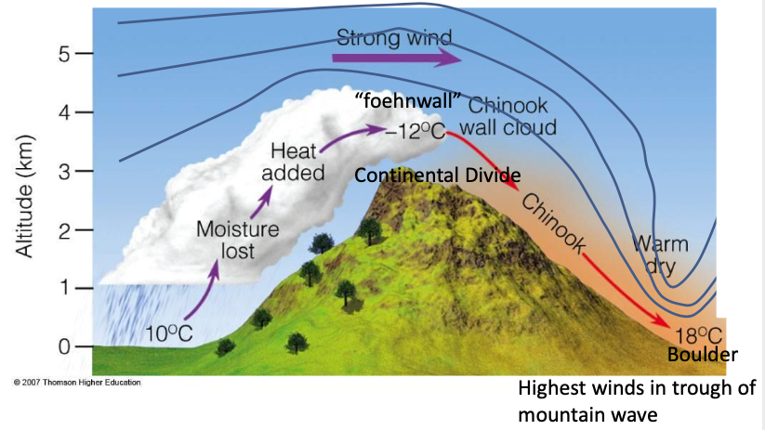
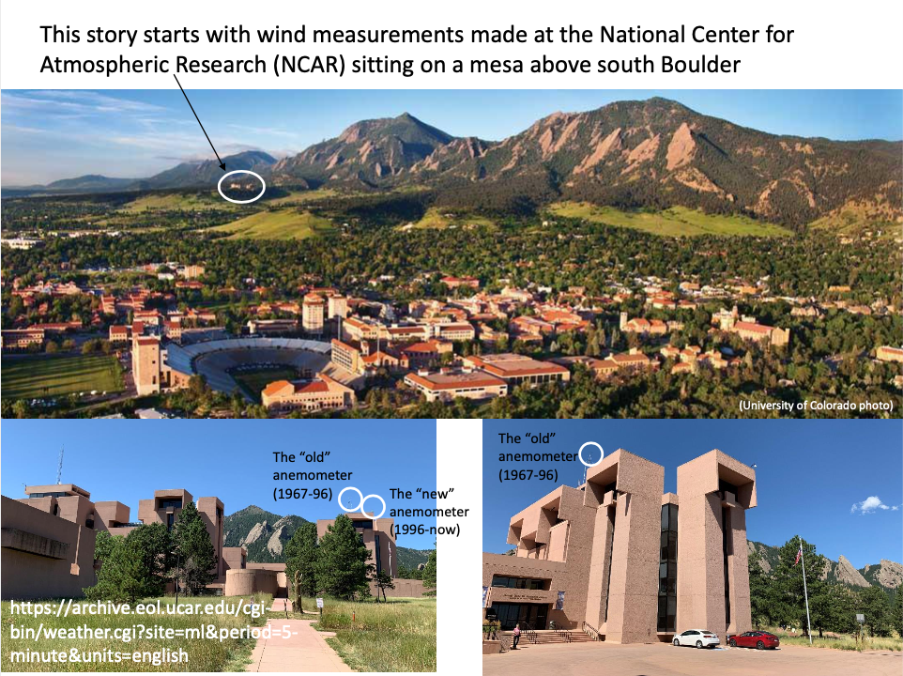
RESEARCH TOPIC HAVE WE EXPERIENCED A CHANGE IN SEVERE *CHINOOK WIND EVENTS IN BOULDER?
A warm dry wind which blows down the east side of the Rocky Mountains at the end of winter.

Slide 3
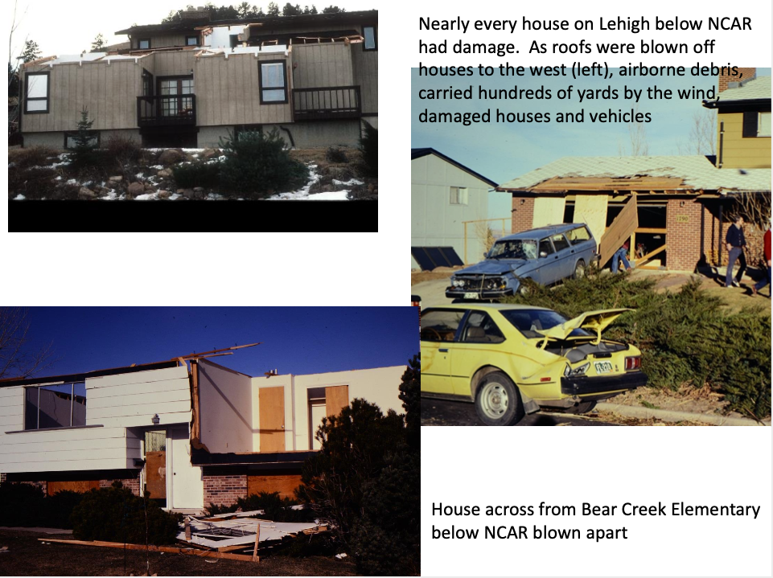
What have we observed in the past?
Boulder citizens awoke on the morning of January 17, 1982 (if they slept at all) to extensive damage across the city due to a Chinook Wind Event.
There was considerable property damage because of the highspeed forceful nature of these winds!

Slide 4
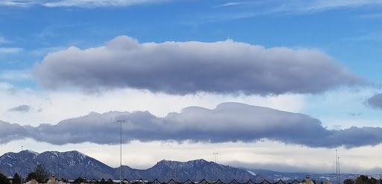
What are we observing now?
It seems as if we are seeing less severe windstorms anymore.
The purpose of this research is to help explain the “Why”.
Potential Hypotheses: Could this be due to new/better civil engineering? Technical instruments? Climate Change? What can explain the decline in these catastrophic wind events?

Slide 5
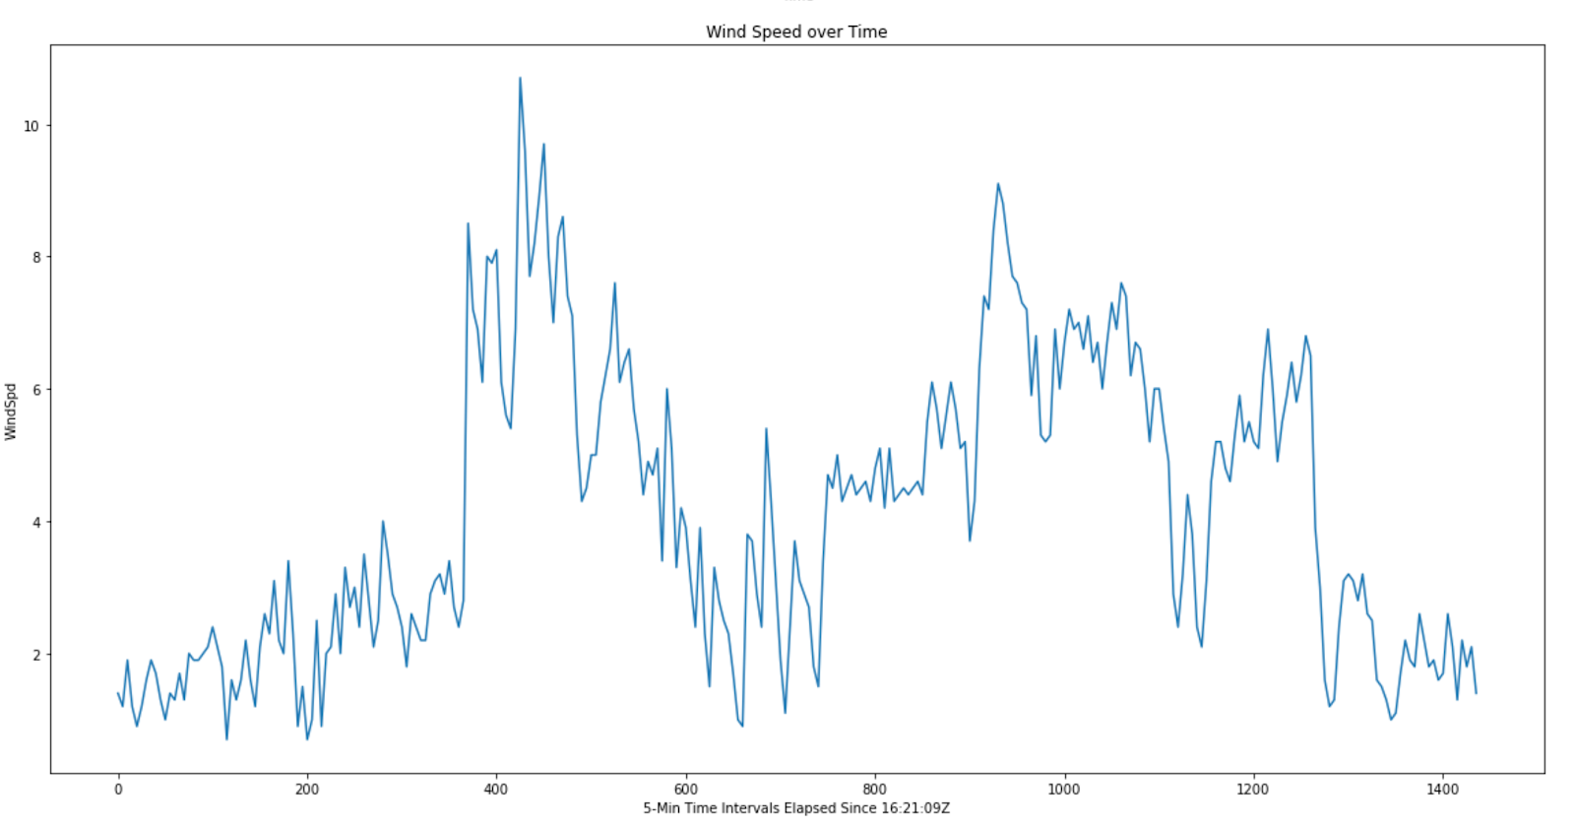
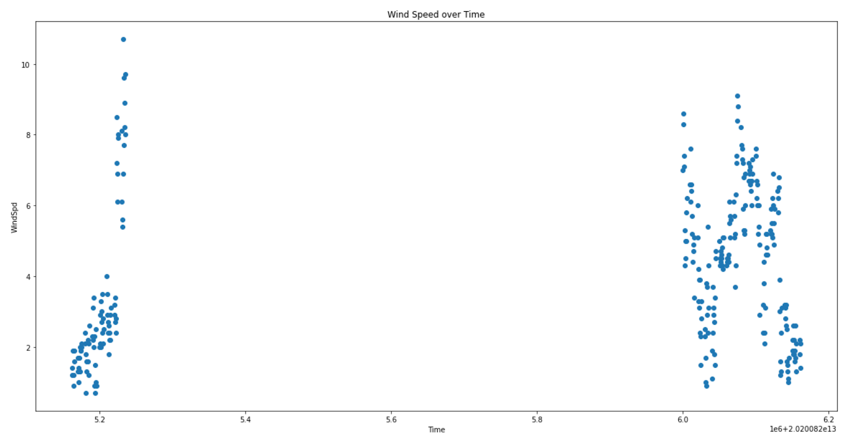
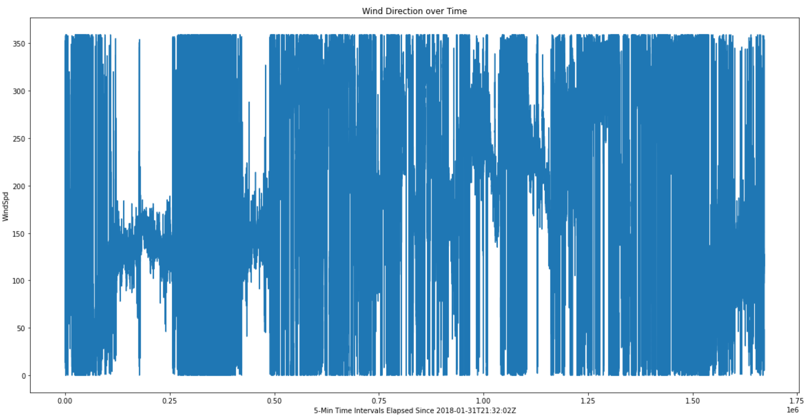
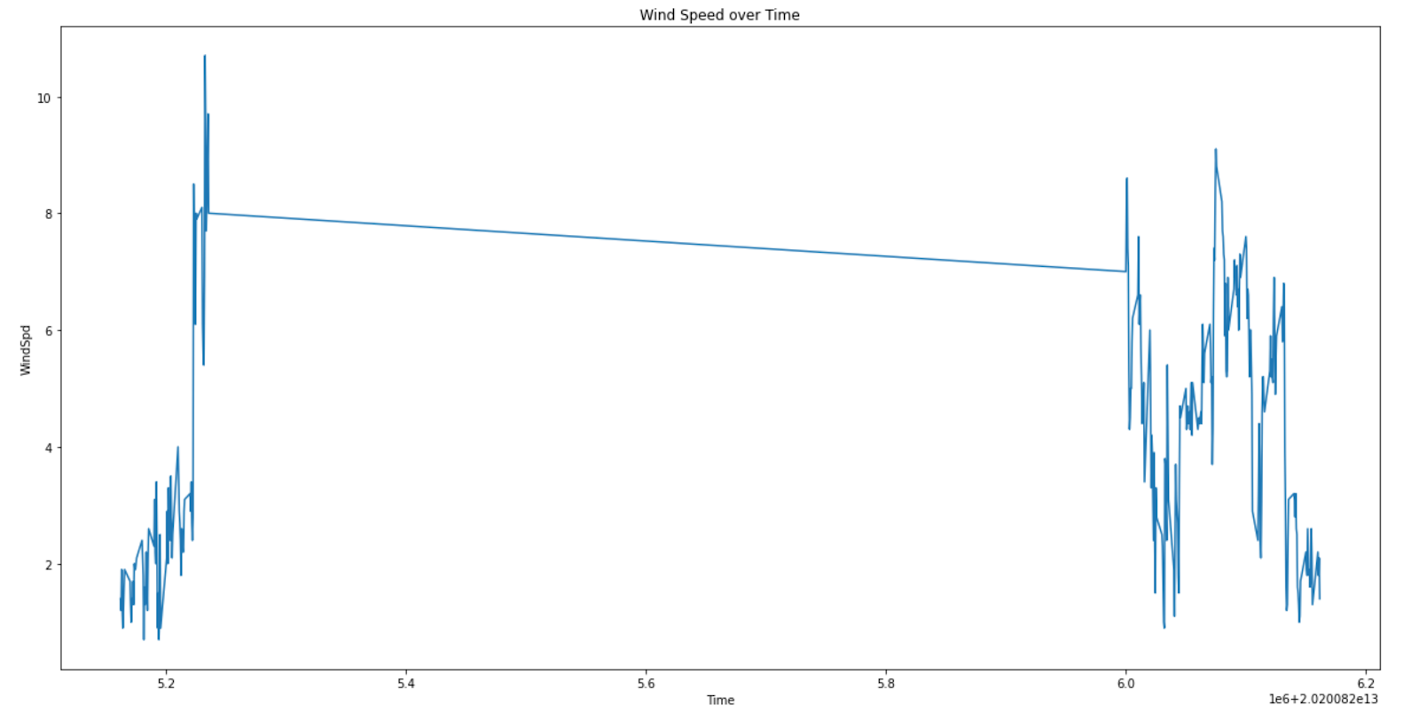
Pre-Data Analysis
First few weeks I needed to plot sample Wind Speed data from anemometer, try different plot styles and see which one works the best! (I had to do a lot of converting of types when I plotted this data and needed to read in the files and store them into proper lists, figure out what they got stored as and convert on a needed basis.
Time was difficult to figure out, but I finally was able to convert timestamps into 5-Minute intervals spread out across time and no longer had that sudden break in between days.
Now that I had the plotting figured out, it was time to move onto the real datasets!
Things I needed to figure out were what the missing values were encoded as in Python, and now once I know what they are, my new goal is to find out how to replace them.
Using Pandas Data frames, I later learned that Python automatically handles the conversion of null types.

Slide 6
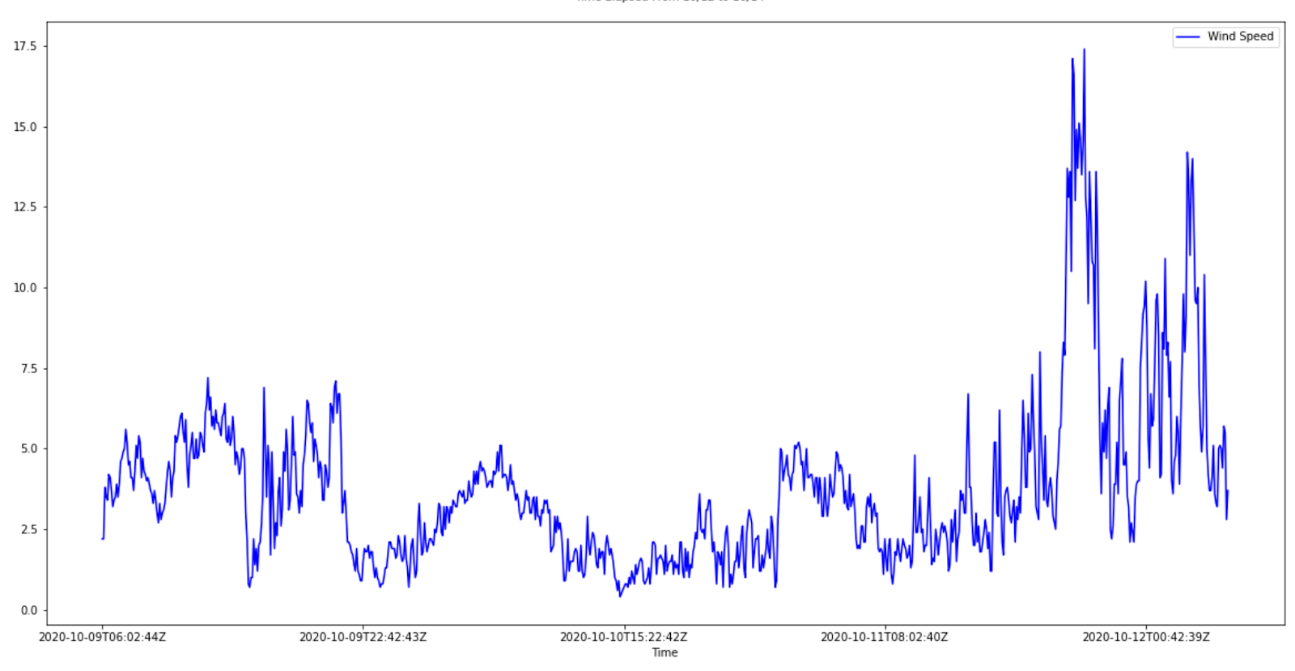
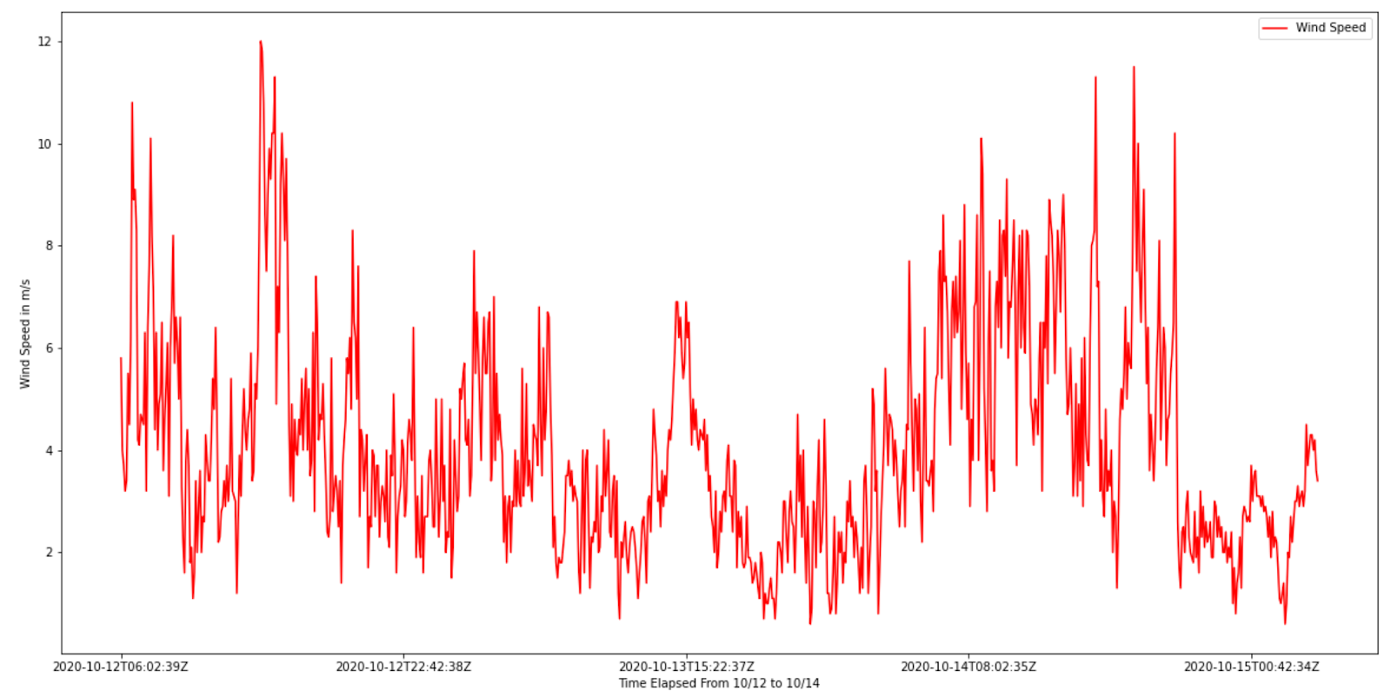
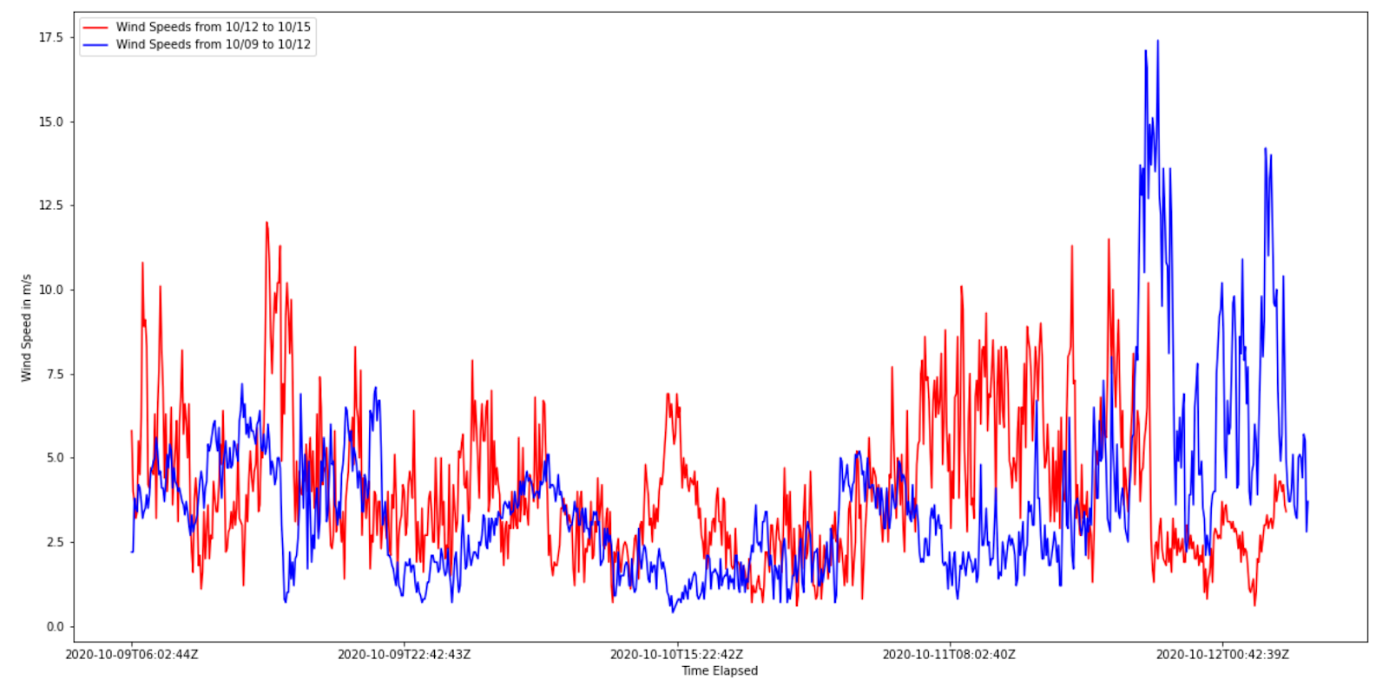
The Graphing Process
Wind Speed (m/s)
Time
Ran some test trials on WXT data files from the end of October. It consisted of a few days, and I used it to test the data processing algorithms on a smaller scale before applying them to the massive, full annual datasets.
Data Observations were taken at 5-minute intervals from the old NCAR Anemometer (WXT) from October 9th through October 12th. October 12th was a particularly windy day in the Foothills area. (Wind speeds recorded in m/s)
I used my small-scale algorithms here and then sized them up as I was ready to tackle the bigger datasets.
Wind Speed (m/s)
Time Elapsed
(10/12/2020 – 10/14/2020)
Wind Speed (m/s)
Time

Slide 8
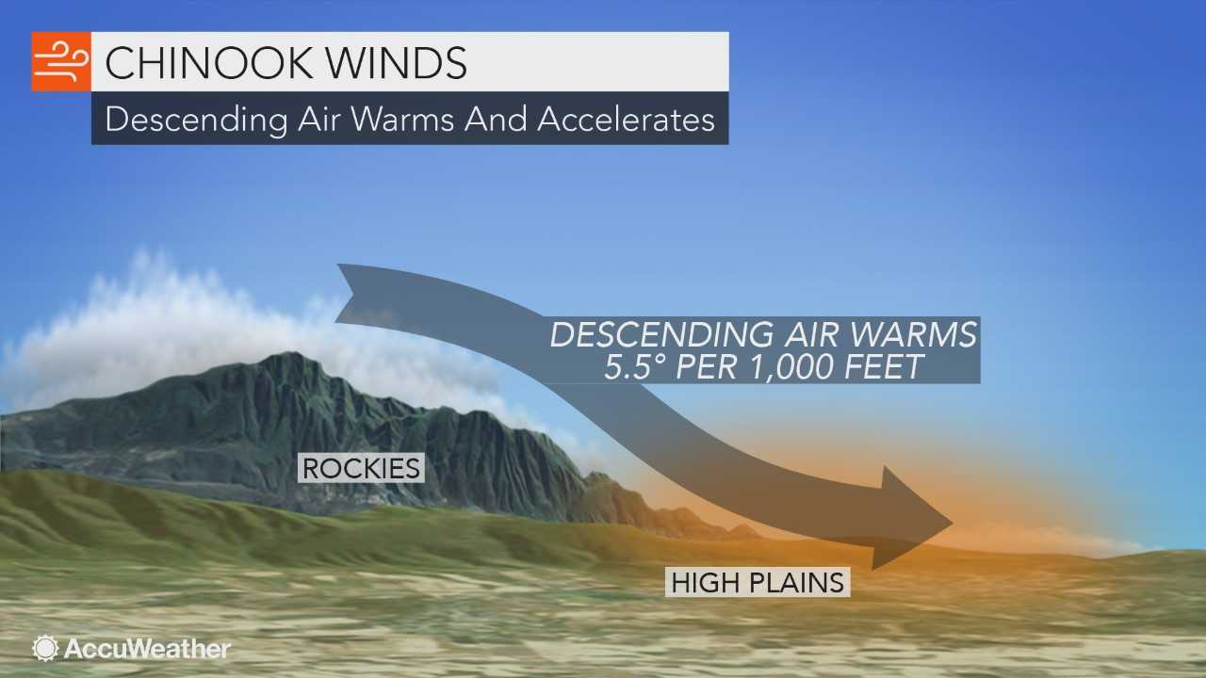
Recap
Studying Chinook Wind Events in Boulder, CO and trying to understand why wind speeds in these events have weakened over the years. Is this perhaps due to some changes in climate, or is this due to newer/updated wind instruments?
Spent first few weeks making charts with sample wind speed data, trying to read in csv files in Python, and did some exercises with cleaning and prepping analysis data in order to make an accurate graph.
Started using Pandas to read in the data more efficiently. Created plots showcasing the higher Wind Speeds we observed over October 12th – October 15th and compared that to what normal wind speeds look like.

Slide 9
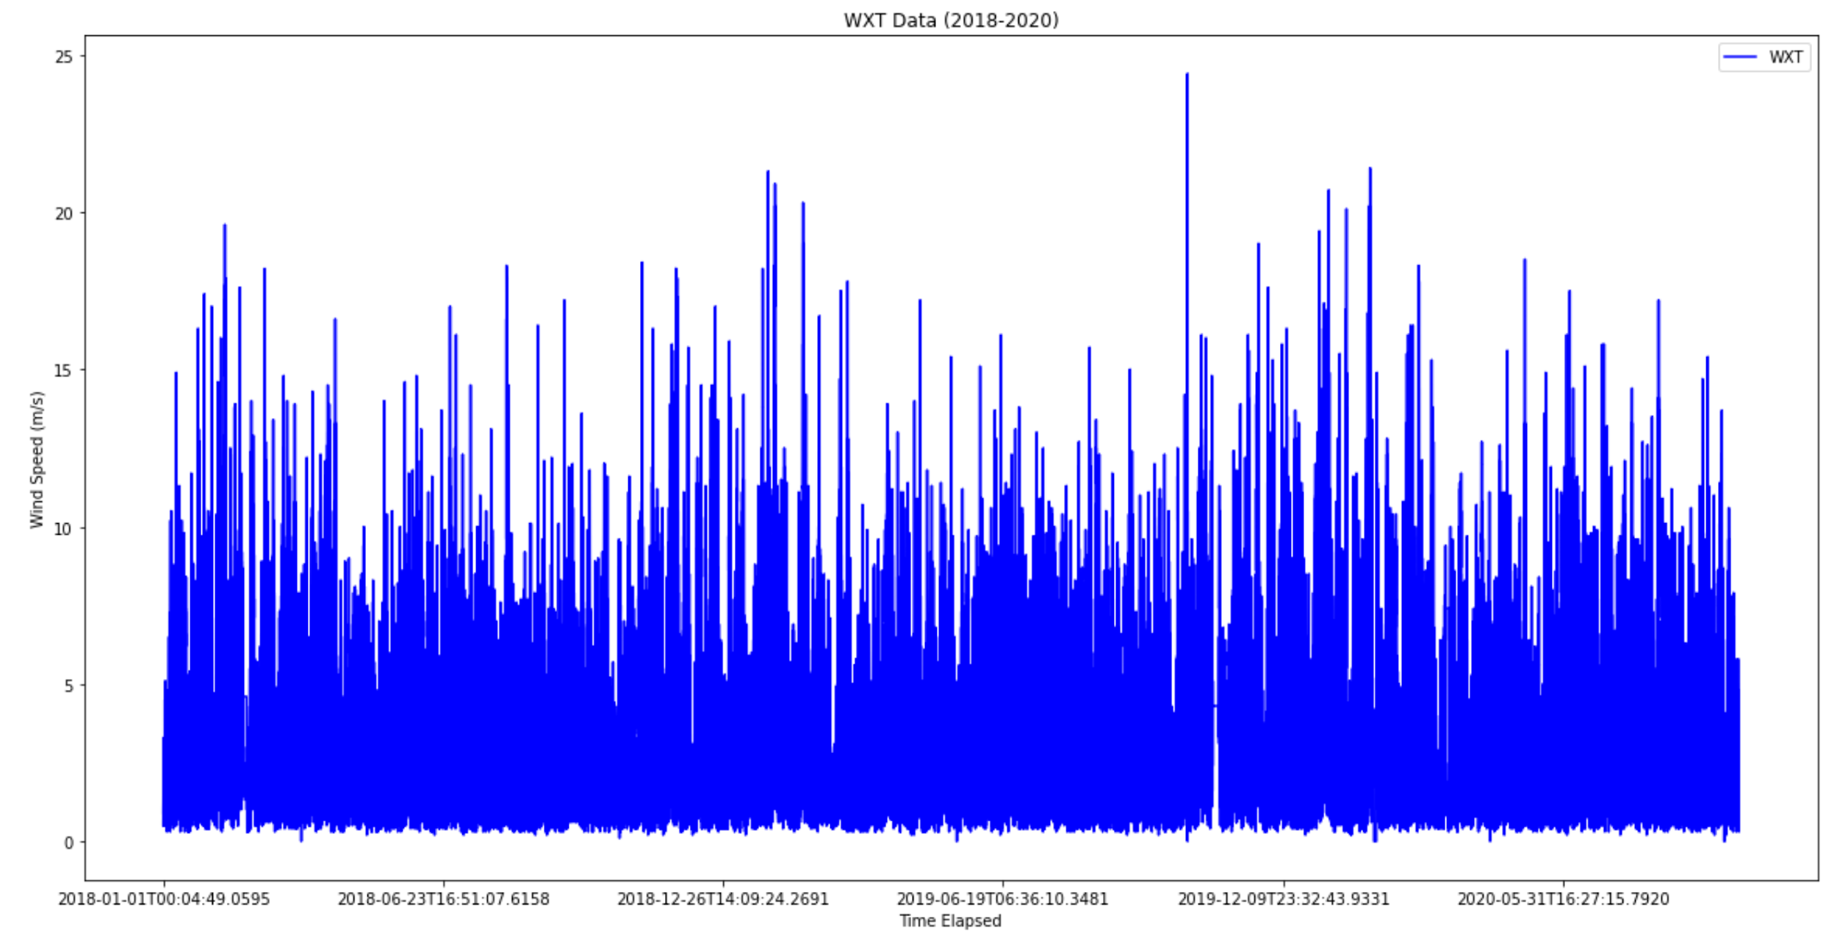
WXT DATA (2018 – 2020)
This is a plot of all the WXT Data we have on record currently from 2018 – 2020.
There is obviously some missing data that the daily averages taken later in the presentation smooths over.

Slide 10
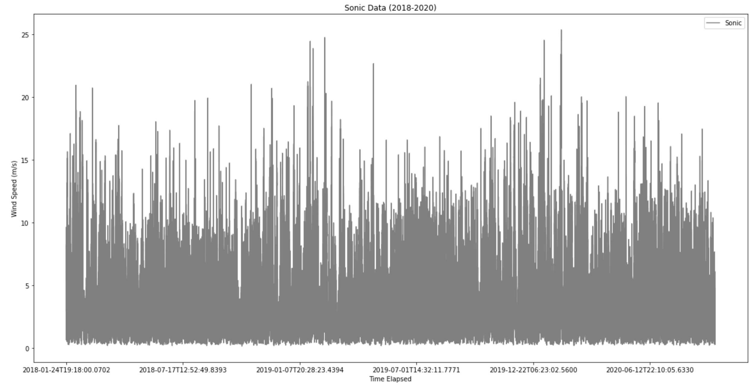
SONIC DATA (2018 – 2020)
This is a plot of all the Sonic Data we have on record currently from 2018 – 2020.
There is obviously some missing data that the daily averages taken later in the presentation smooths over.
This needed to be averaged over 5 -minute intervals in order to match the WXT Graph.

Slide 11
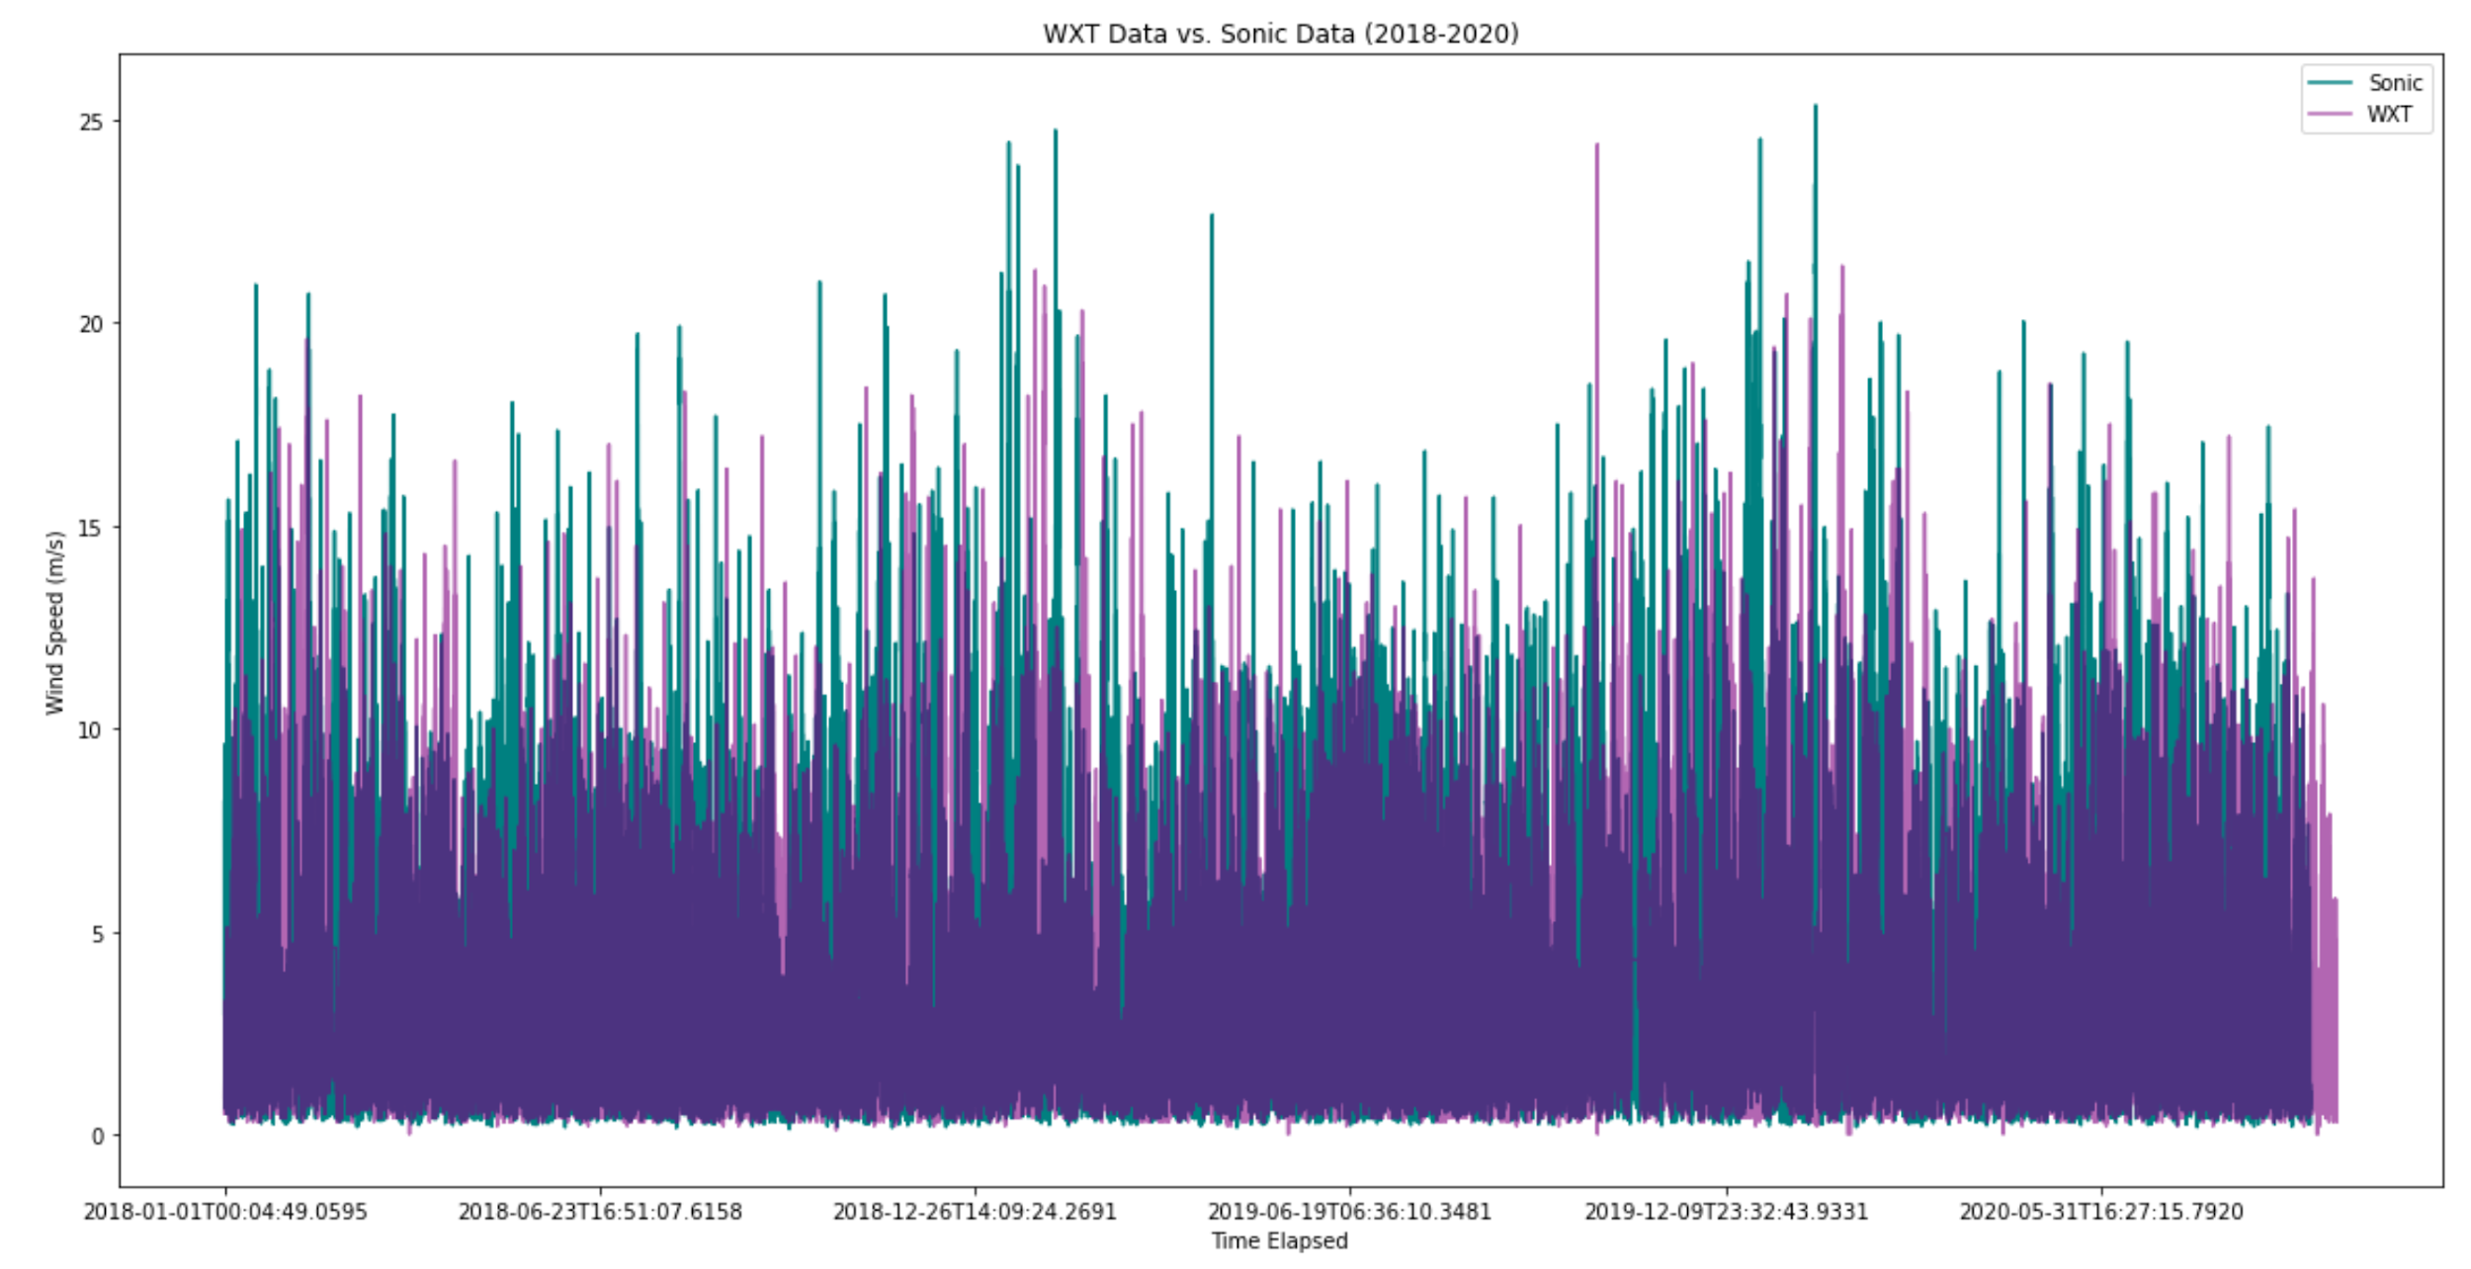
OVERLAID DATA FOR SONIC AND WXT (2018-2020)
Here we look at the full data across both Sonic and WXT.
As mentioned in my Sonic Slide, I needed to average the wind speed across 5-minute intervals in order for it to line up with the WXT data.
This is the graph for Sonic data and WXT data overlaid on top of one another so we can clearly see Sonic comes in with higher wind speeds.

Slide 12
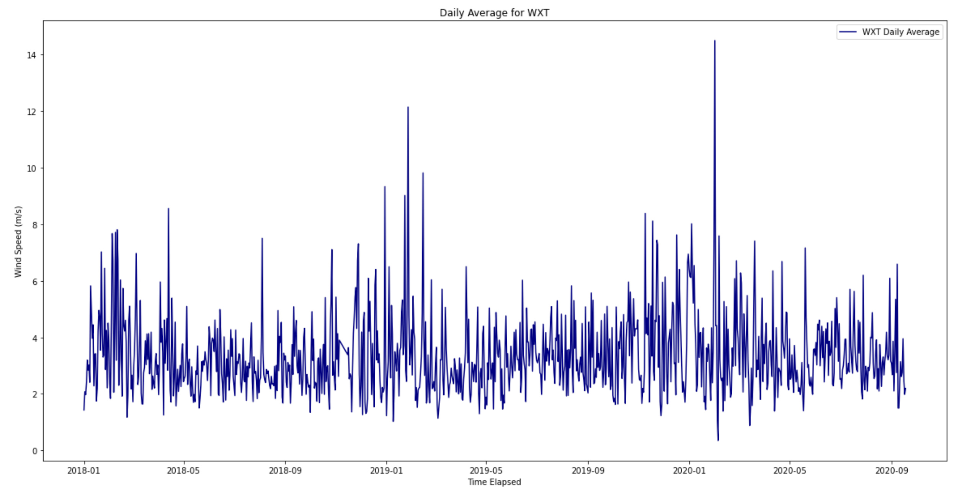
WXT DAILY AVERAGES (2018 – 2020)
This is a plot showing averaged daily wind speeds from the WXT Anemometer from the beginning of 2018 to about midway through 2020.

Slide 13
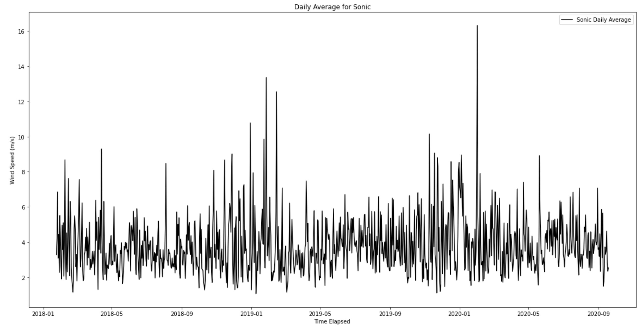
SONIC DAILY AVERAGES (2018 – 2020)
This is a plot showing averaged daily wind speeds from the Sonic Anemometer from the beginning of 2018 to about midway through 2020.

Slide 14
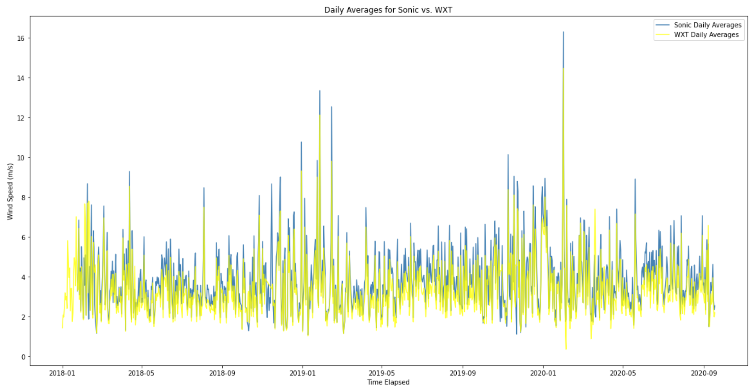
DAILY AVERAGES FOR SONIC AND WXT
Here we look at the daily averages across both Sonic and WXT.
I essentially took mean wind speed and direction over the course of one day worth of data for both anemometers.
This is the graph for Sonic data and WXT data overlaid on top of one another so we can clearly see Sonic comes in with higher daily average wind speeds.

Slide 15
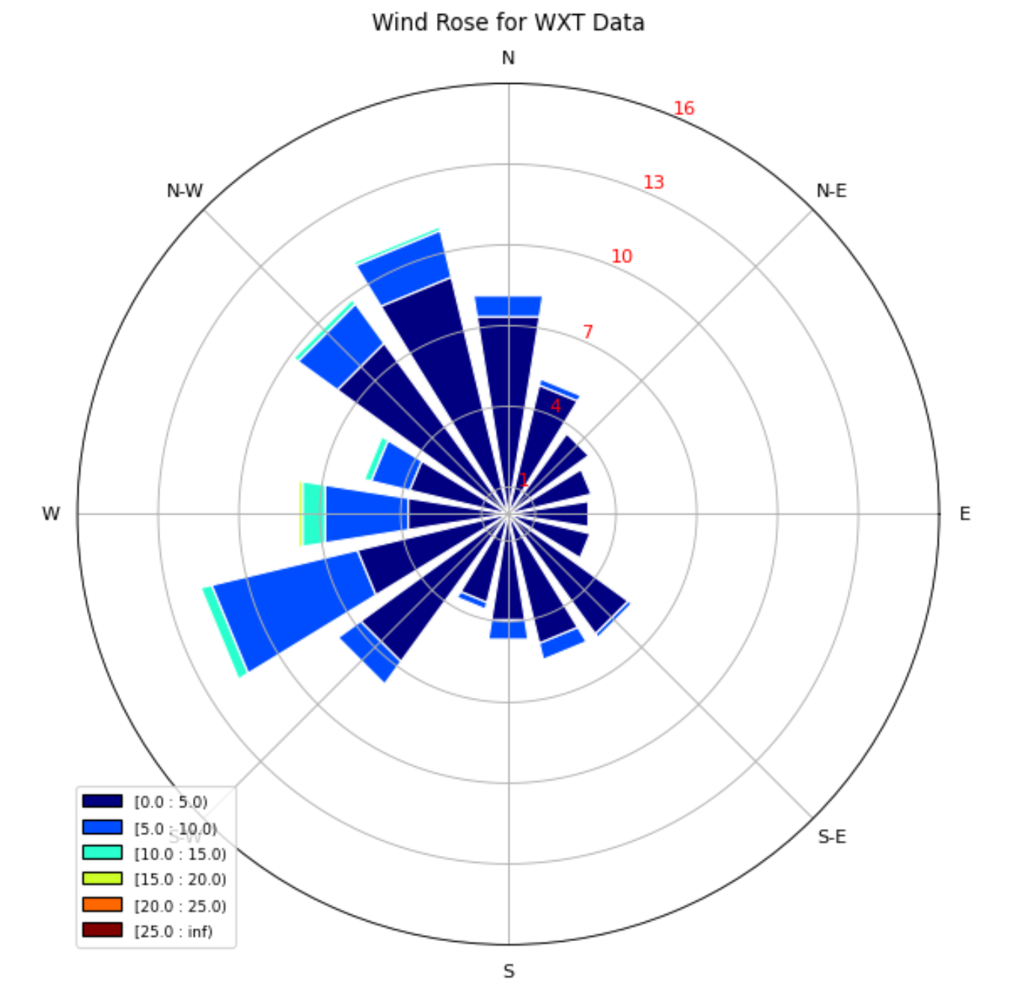
WXT WINDROSE
Time Slices (Normalized
Percentages)
Data from all WXT Files Concatenated (2018, 2019, and 2020)
Bins set to 30 with a step size of 5, and the frequency was from 1 to 18 with a step size of 3. (That’s what the red values on the concentric rings are).
Wind Speed (m/s)

Slide 16
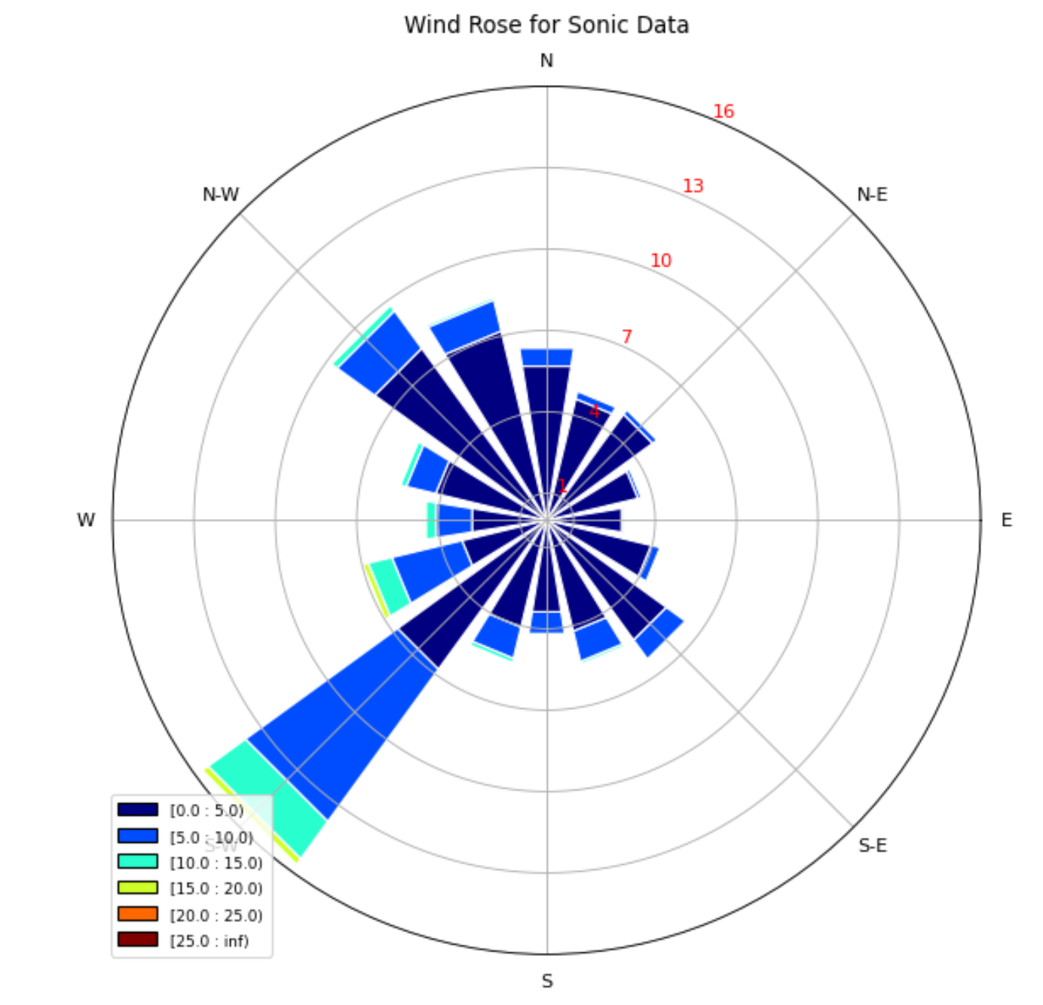
SONIC WINDROSE
Time Slices (Normalized
Percentages)
Data from all Sonic Files Concatenated (2018, 2019, and 2020)
Bins set to 30 with a step size of 5, and the frequency was from 1 to 18 with a step size of 3. (That’s what the red values on the concentric rings are).
Wind Speed (m/s)

Slide 17
SIDE BY SIDE COMPARISON
Time Slices (Normalized
Percentages)
Time Slices (Normalized
Percentages)
It is evident from this side-by-side view of the WXT data and Sonic data that the Sonic has higher wind readings overall.
Wind Speed (m/s)
Wind Speed (m/s)

Slide 18
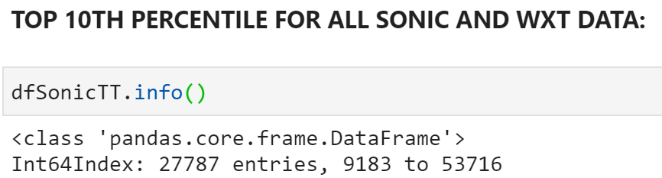
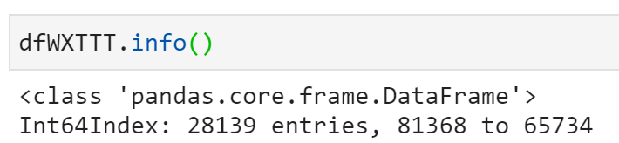
TOP TEN PERCENTILE COMPARISONS
The next job was to narrow the data down into the top 10th percentile of max wind speeds for WXT and Sonic both.
First, I concatenated all WXT records from 2018 – 2020, did the same thing for Sonic (after averaging every 300th data point: Sonic is in 1 second intervals, and WXT is in 5-min intervals, so 5 min = 300 seconds).
Then, I had to “un-sort” the data so that the datetime variable would line up nicely. (Before this step, the data frames were sorted by Wind Speed in m/s).
Finally, I plotted the graph AND wind roses for both the Sonic and WXT Anemometers using that Top Tenth Percentile I calculated.

Slide 19
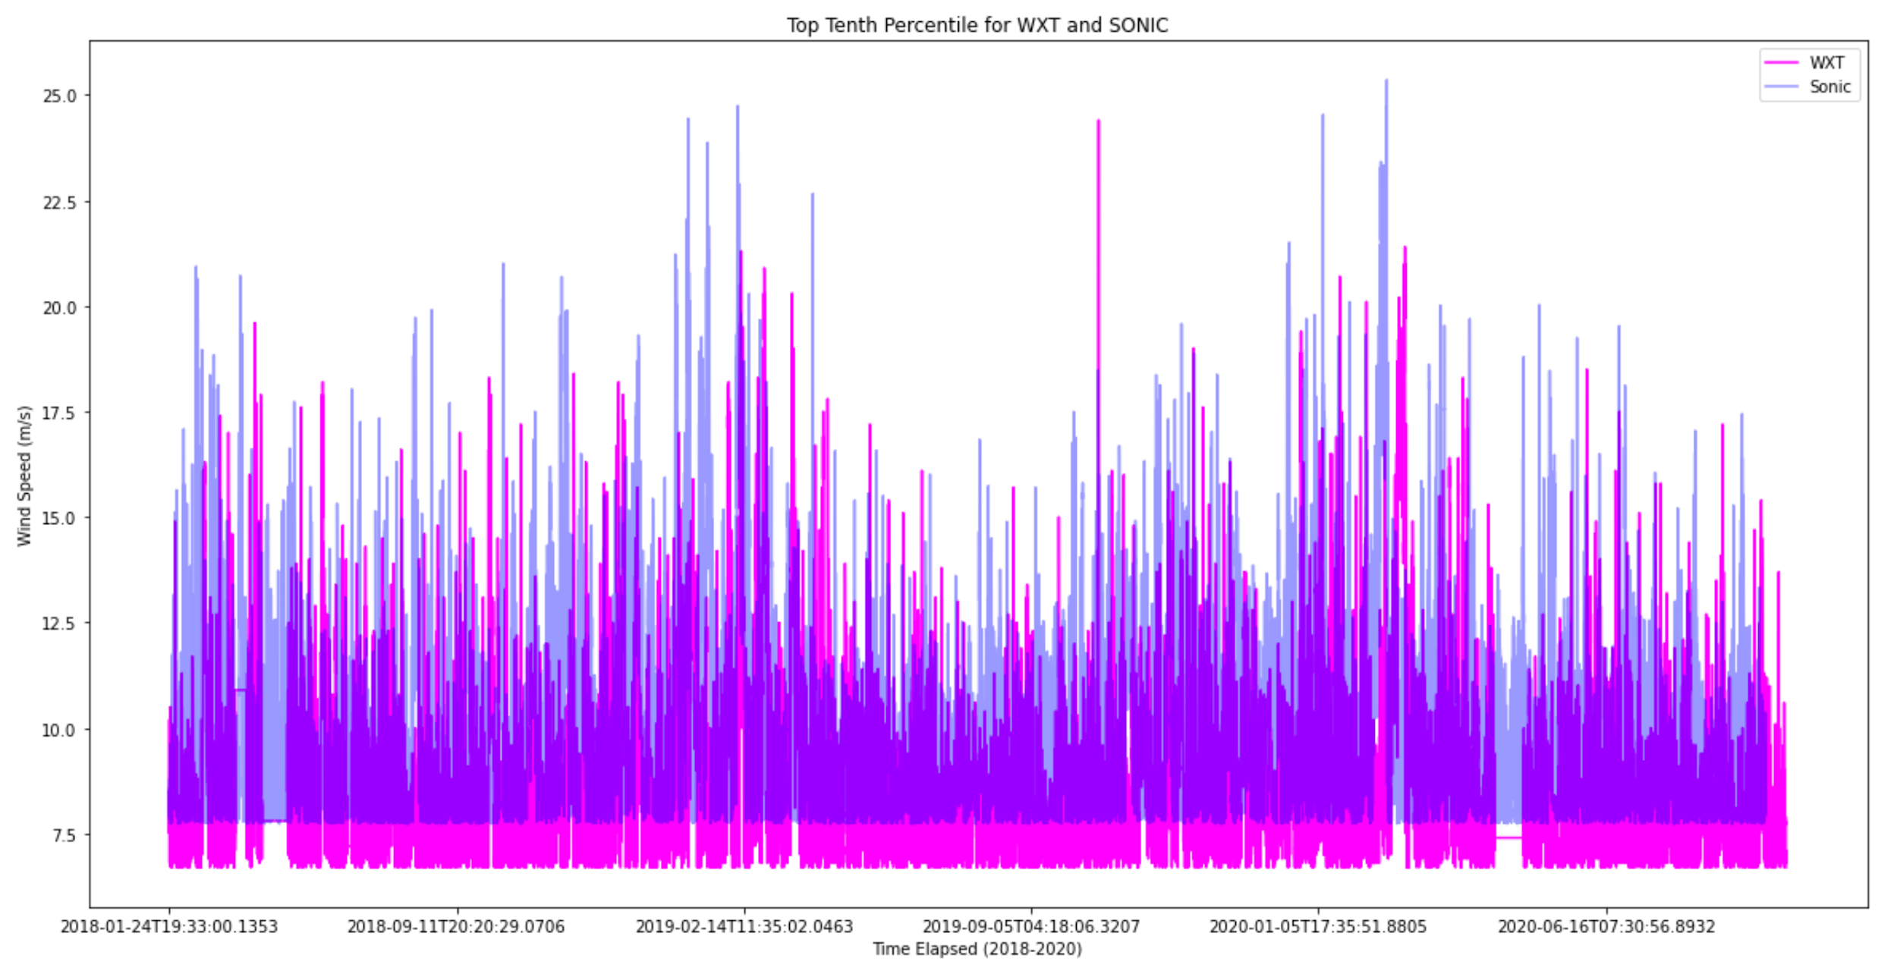
SONIC VS. WXT PLOT (TOP TEN)
Here you can see the Sonic data is considerably higher than WXT on average except for a few special points.
We still have some noise in this data (and missing data chunks) that need to be smoothed out.

Slide 20
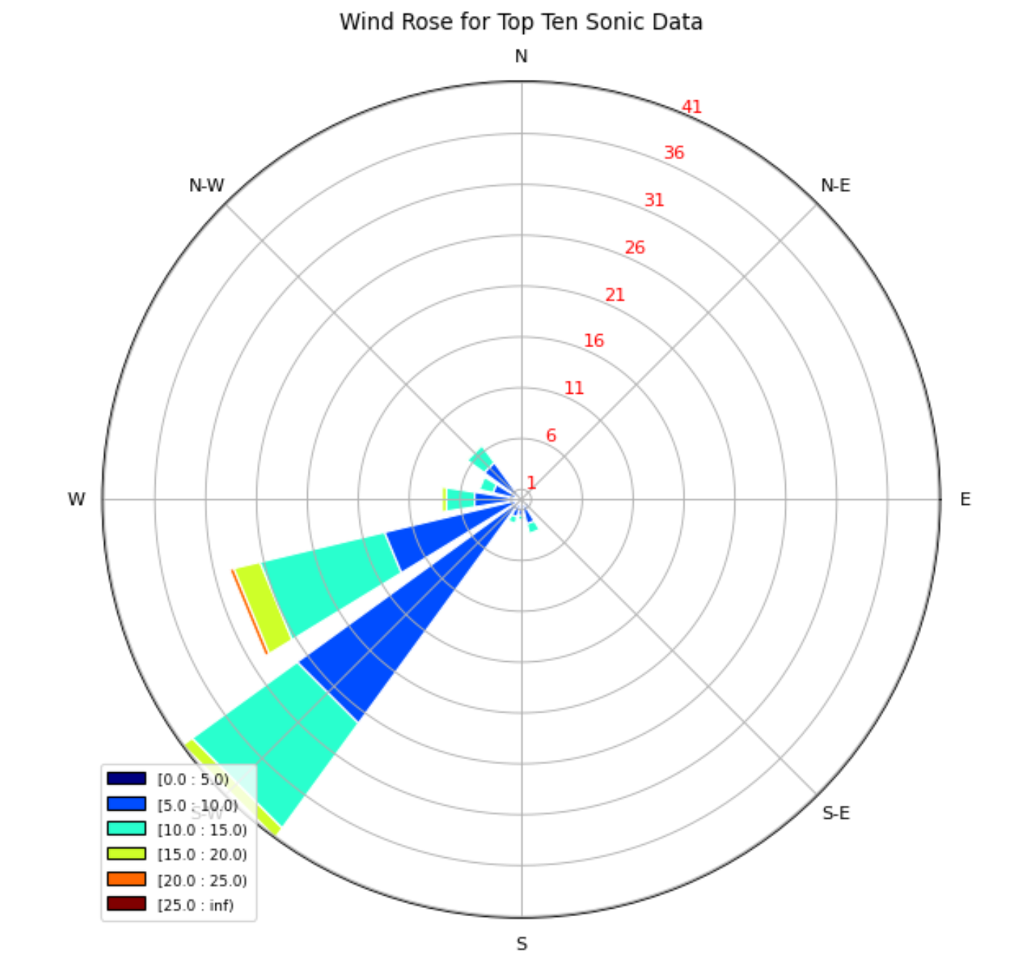
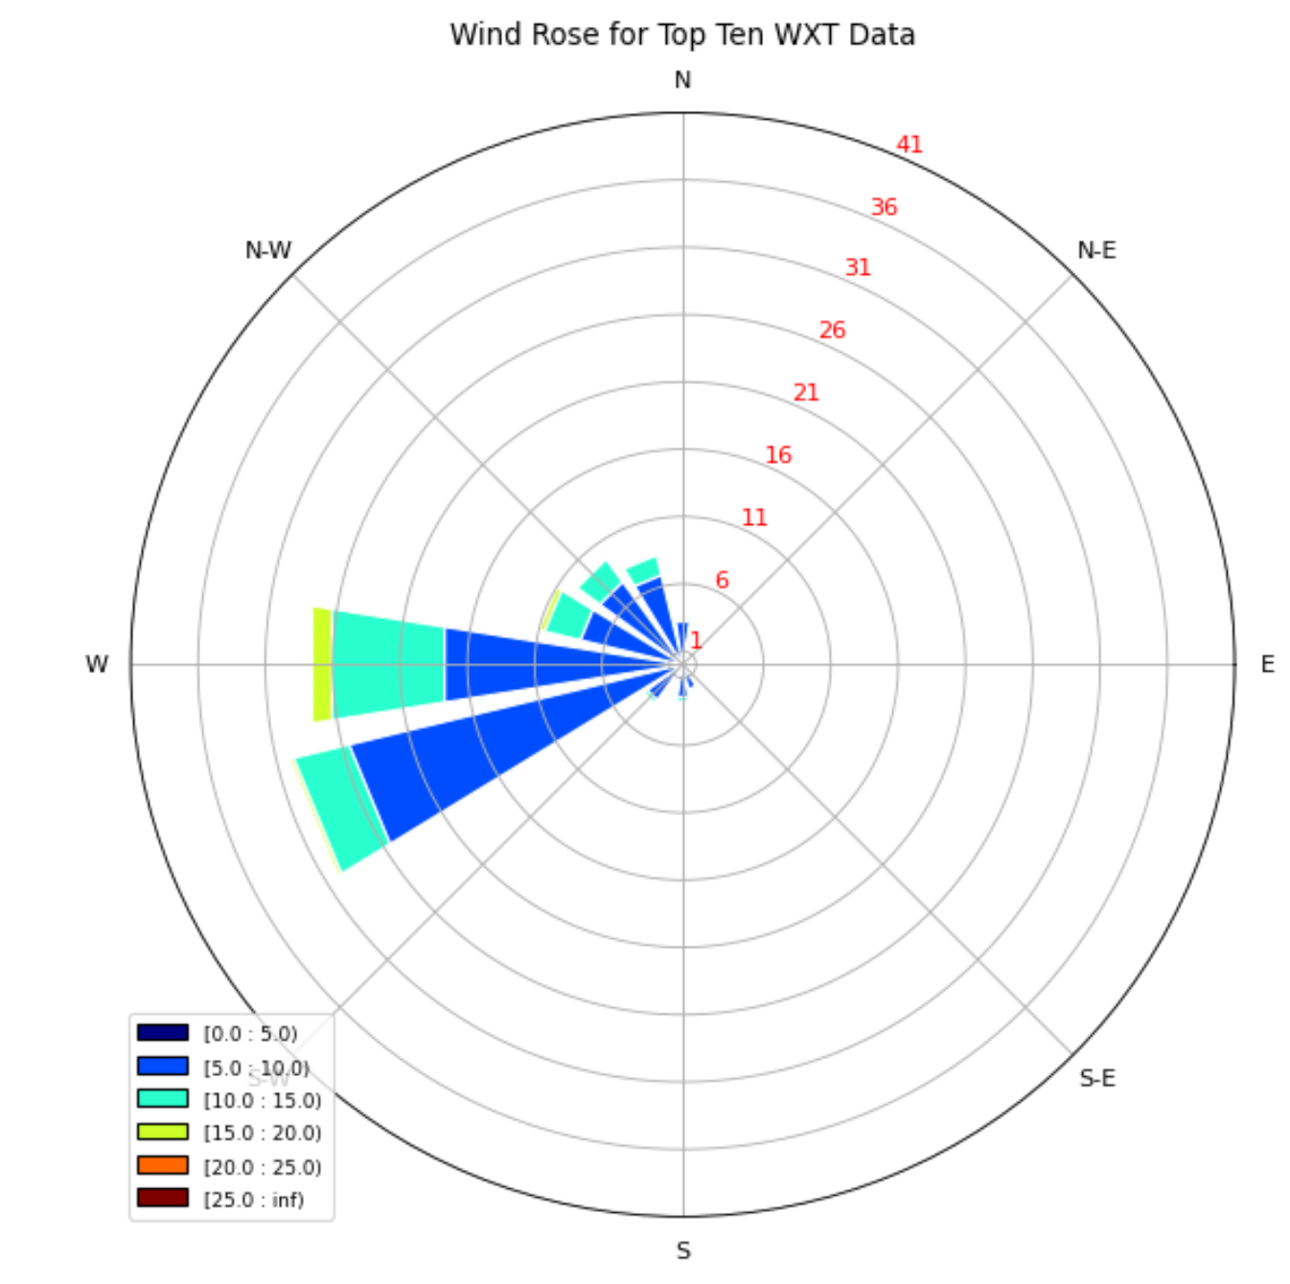
SONIC VS. WXT WIND ROSES (TOP TEN)
It is, once again evident from this side-by-side view of the WXT data and Sonic data that the Sonic has higher wind readings overall.
Time Slices (Normalized
Percentages)
Time Slices (Normalized
Percentages)
Wind Speed (m/s)
Wind Speed (m/s)

